Slide 1
Service Improvement
Process Concepts
Notes:
IT Asset Management Concepts HP Confidential
OK

Slide 2

Objectives of this Session
To develop a deeper understanding of the Service Improvement process:
  Why organizations implement Service Improvement
  What is Service Improvement
  How Service Improvement is used
  Best implementation practices
To understand how Service Improvement
fits into the bigger scheme of the ITIL
Continual Service Improvement phase
Service Improvement Concepts HP Confidential
Notes:
(c) 2007 Hewlett Packard Development Company, LP
Microsoft I&SRM workshop agenda
October 2006

Slide 3

Service Improvement
Purpose
The Service Improvement process is designed and implemented to manage improvements to the IT Services and Service Management processes.
Service Improvement Concepts HP Confidential
Notes:
Service Improvement Process is part of the Continual Service Improvement practice.
The performance of the IT Service Provider is continually measured and improvements are made to processes, IT Services and IT Infrastructure in order to increase efficiency, effectiveness, and cost effectiveness.

Slide 4

Service Improvement
Goals
Recommend improvements to service quality, effectiveness and efficiency
Recommend improvements to Service Management processes
Service Improvement Concepts HP Confidential

Slide 5
Service Improvement
Scope
IS | IS NOT
Reviewing service level information and service trends | Defining metrics for measurement, gathering or processing the data (Service Measurement and Reporting)
Reviewing Service Management information and trends for all Service Management processes
Reviewing the relevance of service deliverables
Conducting external and internal service reviews in order to identify Continual Service Improvement opportunities
Making improvement recommendations | Recommending corrective actions for individual processes and services (Individual processes and services)
Service Improvement Concepts HP Confidential

Slide 6
Service Improvement
Scope (cont’d)
IS | IS NOT
Requesting approval of improvement recommendations | Approving improvement recommendations (Responsibility of the individual processes and services)
Implementing improvements | Taking corrective action (Responsibility of the individual processes and services)
Service Improvement Concepts HP Confidential

Slide 7
Service Improvement
Key Definitions
Service Improvement Plan (SIP) | A program or plan to implement improvements to service assets in a controlled way.
Organizational Change | The addition, modification or deletion of some or all aspects of an organization, including:
Strategy
Architecture
Structure
Maturity
Cultures
Values and belief
People
Relationships
Processes
Procedures
Tools
Work Patterns
Attitude
Rules
Competencies
(Unwritten) Practices
Service Improvement Concepts HP Confidential

Slide 8
Continual Service Improvement
Service Strategy
Service Measurement
Business, IT & Supporting Service
Organization
People
Service Reporting
Service Operations
Knowledge
Service Design
Business
Initiatives
Configuration Items
Service Improvement
Process Management
Competencies
Service Transition
Service Improvement Concepts HP Confidential

Slide 9
Service Improvement
Process Relationship
Service Measurement and Reporting
Service Management Other Processes and Functions
Reports
Service Improvements
Service Improvement Inputs
Improvements
Service Improvement
Service Improvements
Changes to the Service
Service Level requirements and Targets
Service Portfolio Data
Service Level
Management
Service Portfolio Management
Service Improvement Concepts HP Confidential
Notes:
Service Measurement and Reporting process provides “Reports” as input to Service Improvement. And Service Improvement process provides “Improvements” as output to the Service Measurement and Reporting.
Service Measurement other processes and Functions process provides “Service Improvements” as input to Service Improvement. And Service Improvement process provides “Service Improvement Inputs” as output to the Service Measurement other processes and Functions.
Service Portfolio Management process provides “Service Portfolio Data” as input to Service Improvement. And Service Improvement process provides “Changes to the Service” as output to the Service Portfolio Management.
Service Level Management process provides “Service Level Requirements and targets” as input to Service Improvement. And Service Improvement process provides “Service Improvements” as output to the Service Level Management.

Slide 10
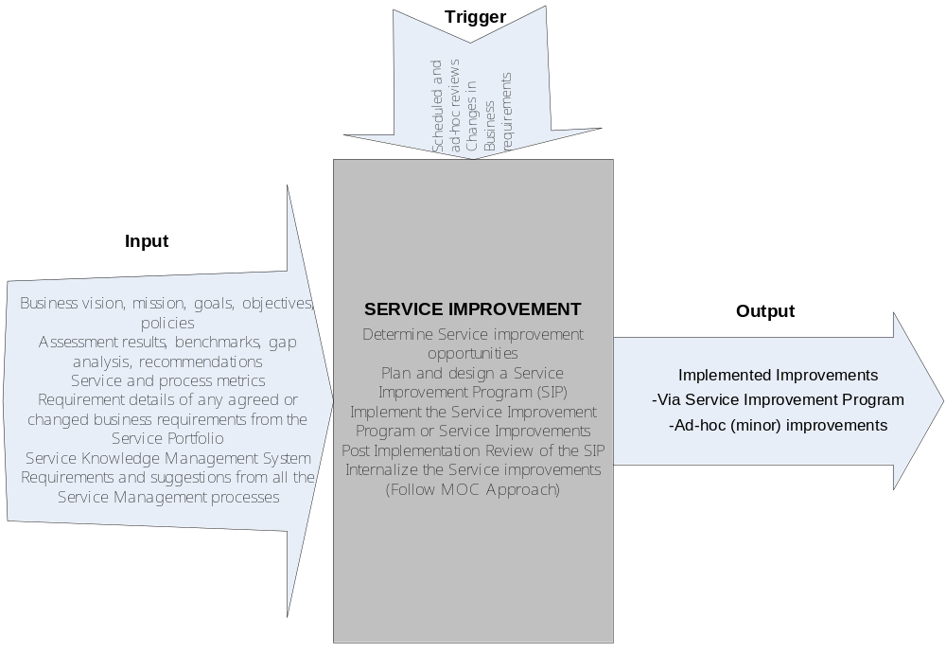
Service Improvement
Triggers, Input and Output
Service Improvement Concepts HP Confidential

Slide 11

Service Improvement
Roles
Service Owner
CSI Manager
CSI Process Owner
Service Improvement Concepts HP Confidential

Slide 12
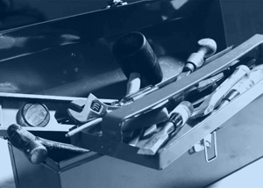
Service Improvement
Tools
Statistical Analysis Tool
Business Intelligence and Reporting
Knowledge Management
Performance Management
Service Improvement Concepts HP Confidential
Notes:
Analysis and Data gathering tools

Slide 13
Service Improvement
Critical Success Factors
Adoption of Continual Service Improvement culture within the organization
Accurate input: assessments, benchmarks, gap analysis
Accurate and timely Business information
  Goals and Objectives
Clearly defined targets
  “Where we want to go”
Sufficient and ongoing funding for CSI activities
Service Improvement Concepts HP Confidential
Notes:
Other Critical Success Factors:
• Defining clear criteria for prioritizing improvement projects
• Appointment of a CSI manager
• Management commitment – this means ongoing, visible participation in CSI activities such as creating vision for CSI, communicating vision, direction setting and decision making, when appropriate
• Adoption of the service lifecycle approach
• Resource allocation – people are dedicated to the improvement effort not as just another add-on to their already long list of tasks to perform
• Technology to support the CSI activities
• Adoption of processes – embracing service management processes instead of adapting it to suit their own personal needs and agenda.

Slide 14

Service Improvement
Best Practices
Adopt the Managing Organizational Changes (MOC) process to manage cultural changes
Establish a clear line of communication and delegation of improvement activities
Post-implementation analysis is conducted to measure the output of the Service Improvement Program (SIP)
Service Improvement Concepts HP Confidential

Slide 15

Service Improvement
Metrics
The percentage of difference between baseline (”where were we”) vs. new metrics (“where are we now”)
Number of proposed improvements implemented
Were the targets defined during the Service Improvement process achieved
Service Improvement Concepts HP Confidential
Notes:
Other Key Performance Indicators
Improvement in other processes
Examples: Improvement in Customer satisfaction, percentage decrease in metric violations, improved employee morale

Slide 16
Service Improvement
Goals/KPI/CSF Mapping Table
Goal | KPIs | CSF
Recommend improvements to service quality, effectiveness, and efficiency | Improvement in customer satisfaction | Clearly defined targets “where we want to go”
Recommend improvements to Service Management processes | Number of Service Improvement initiatives / recommendations that resulted in Service Management processes improved | Adoption of Continual Service Improvement culture within the organization
Service Improvement Concepts HP Confidential

Slide 17
Thank you
Questions?
Notes:
IT Asset Management Concepts HP Confidential

